Slide 1
Safety
in the AgriScience classroom

Slide 2
Opening Activity
In your own words define “safety”

Slide 3
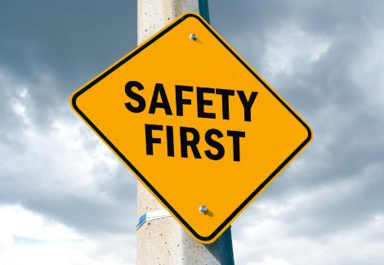
Textbook Definition
Safety – the condition of being free of harm and danger; preventing injury and loss
Agriscience. Turner (2010)

Slide 4
Proper Dress
Clothes worn in the AgriScience classroom should be:
Comfortable
Weather appropriate
Properly fitting
Durable
Able to get wet or dirty
Allows free range of motion

Slide 5
Proper Dress
Avoid clothing and accessories that:
Are loose fitting
Too tight
Have things dangling from them
Are prone to tearing or damage
Don’t clean easily

Slide 6
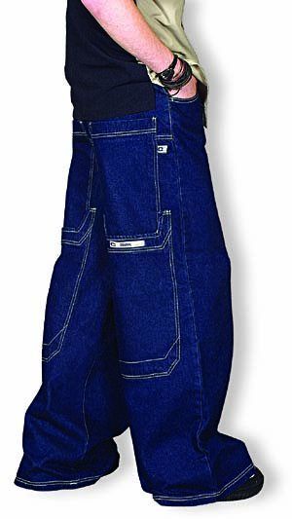
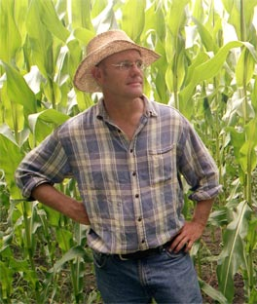

Slide 7
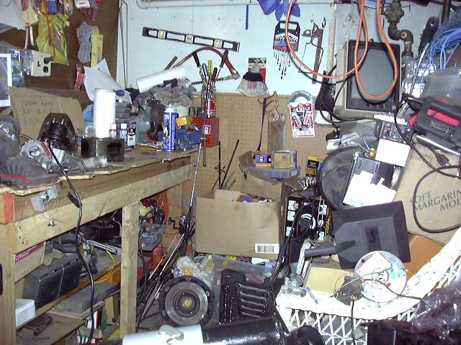
Work Area
Neat and clear of clutter
Tools easily accessible
Tools put back in proper place when finished
Scrap materials placed in proper receptacle

Slide 8
PPE
Personal Protection Equipment!
Task specific protection must be worn whenever physical harm is possible
Must be worn whenever appropriate

Slide 9
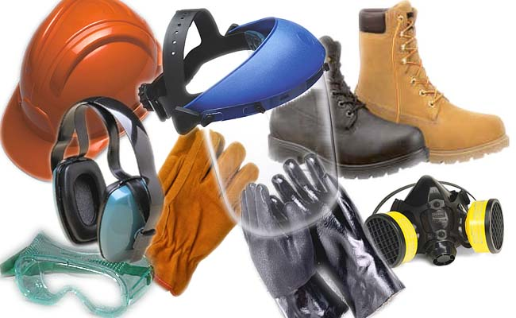
PPE
Footwear
Hearing Protection
Dust or particle mask
Face shield
Safety glasses
Gloves
Apron

Slide 10
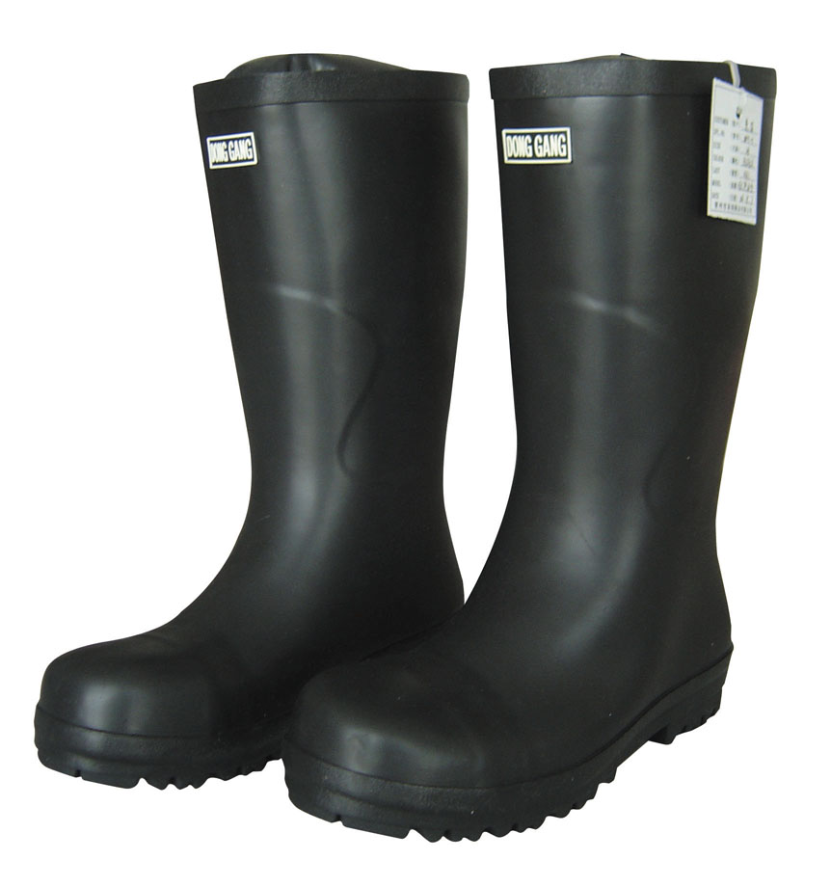
PPE
Footwear
Hearing Protection
Dust or particle mask
Face shield
Safety glasses
Gloves
Apron

Slide 11
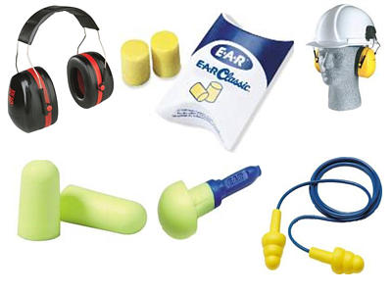
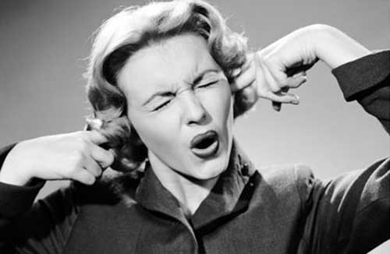
PPE
Footwear
Hearing Protection
Dust or particle mask
Face shield
Safety glasses
Gloves
Apron

Slide 12
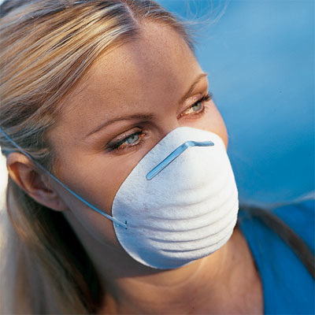
PPE
Footwear
Hearing Protection
Dust or particle mask
Face shield
Safety glasses
Gloves
Apron

Slide 13
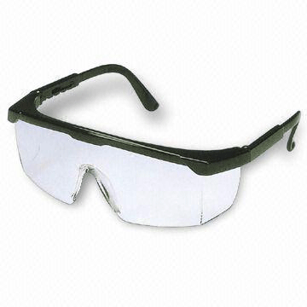
PPE
Footwear
Hearing Protection
Dust or particle mask
Face shield
Safety glasses
Gloves
Apron

Slide 14
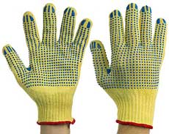
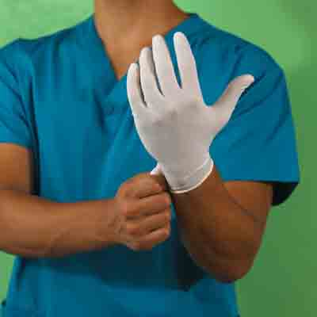
PPE
Footwear
Hearing Protection
Dust or particle mask
Face shield
Safety glasses
Gloves
Apron

Slide 15
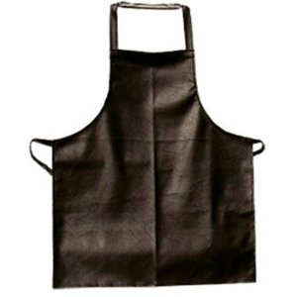
PPE
Footwear
Hearing Protection
Dust or particle mask
Face shield
Safety glasses
Gloves
Apron

Slide 16
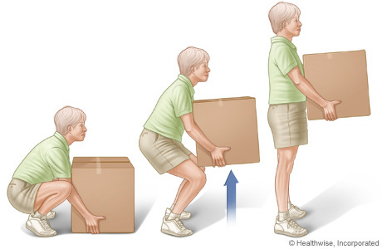
Lifting and Carrying Safety
Always lift using your legs
Keep spine straight
Have clear path of travel
Wear proper footwear
Know your limits!
Ask for help

Slide 17
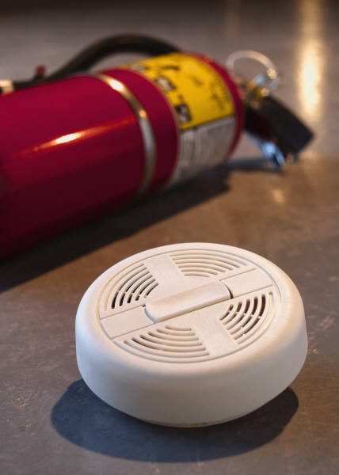
Fire Safety
Watch for potential hazards
Know locations of fire extinguishers
Change batteries in smoke detectors
Pre-plan escape routes
Don’t be a hero
Alert others

Slide 18
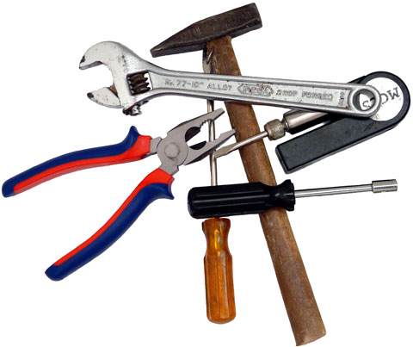
Hand Tools
Even without power, they can still be dangerous
Keep them in good condition
Keep all blades sharp
Watch out for excessive rust
Store properly
Use the proper tool for the job
Eye PPE

Slide 19
Power Hand Tools
Danger sources: moving parts, electricity, sharp blades, heavy
Wear proper PPE when using power tools
Keep work area clean
Plan your work
Inventory risks
Never use around water
Check cords for fraying
Eye and Ear PPE

Slide 20
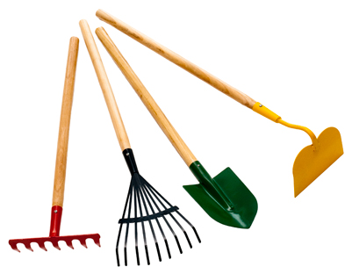
Garden Tools
Make sure handles are not cracked
Always lean upright when not in use
Always make sure sharp ends pointed away from people
Never raise above knee level
Store in proper place
Wear appropriate PPE

Slide 21
First Aid and CPR
First Aid: The initial care given to an injured or ill individual until professional help is available
CPR: Cardiopulmonary resuscitation
Get trained
Practice
Have a well stocked kit on hand
Only do what you know

Slide 22
Electrical Safety
Watch for frayed power cords
Water and electricity do NOT mix
Make sure machines are unplugged before working on them
Always wear rubber-soled shoes

Slide 23
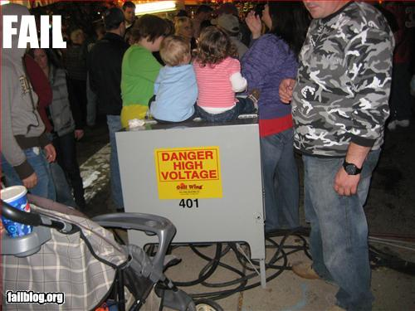

Slide 24
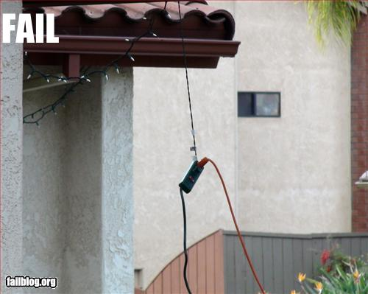

Slide 25
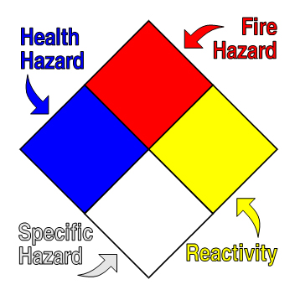
Chemical Safety
When using chemicals, first read MSDS
MSDS: Material Safety Data Sheet
Read labels for warnings
Obey all warnings
Dispose of all chemicals properly
Store chemicals according to their instructions

Slide 26
NFPA
National Fire Protection Association
reduce the worldwide burden of fire and other hazards on the quality of life by providing and advocating consensus codes and standards, research, training, and education.

Slide 27
NFPA

Slide 28
Safety Symbols

Slide 29
When an Accident Occurs
Remove yourself from the dangerous situation if possible
Alert others to the danger
Alert your instructor to ALL accidents, no matter how minor
Seek first aid or medical care if necessary

Slide 30
Risk
What is risk?
How do we define it?

Slide 31
Risk
possibility of loss or injury
someone or something that creates or suggests a hazard
the chance of loss or the perils to the subject matter of an insurance contract; also : the degree of probability of such loss

Slide 32
Risk Management
Risk management is the identification, assessment, and prioritization of risks
Let’s talk through this… what does this mean?

Slide 33
Safety Quiz
A score of 100% is required to pass this course…no exceptions!

